Slide 1
Programming with OpenGL
Part 2: Complete Programs
Ed Angel
Professor of Computer Science, Electrical and Computer Engineering, and Media Arts
University of New Mexico
Angel: Interactive Computer Graphics 5E © Addison-Wesley 2009

Slide 2
Objectives
Refine the first program
  Alter the default values
  Introduce a standard program structure
Simple viewing
  Two-dimensional viewing as a special case of three-dimensional viewing
Fundamental OpenGL primitives
Attributes
Angel: Interactive Computer Graphics 5E © Addison-Wesley 2009

Slide 3
Program Structure
Most OpenGL programs have a similar structure that consists of the following functions
  main():
    defines the callback functions
    opens one or more windows with the required properties
    enters event loop (last executable statement)
  init(): sets the state variables
    Viewing
    Attributes
  callbacks
    Display function
    Input and window functions
Angel: Interactive Computer Graphics 5E © Addison-Wesley 2009

Slide 4
simple.c revisited
In this version, we shall see the same output but we have defined all the relevant state values through function calls using the default values
In particular, we set
  Colors
  Viewing conditions
  Window properties
Angel: Interactive Computer Graphics 5E © Addison-Wesley 2009

Slide 5
main.c
includes gl.h
#include <GL/glut.h>
int main(int argc, char** argv)
{
glutInit(&argc,argv);
glutInitDisplayMode(GLUT_SINGLE|GLUT_RGB);
glutInitWindowSize(500,500);
glutInitWindowPosition(0,0);
glutCreateWindow("simple");
glutDisplayFunc(mydisplay);
init();
glutMainLoop();
}
define window properties
display callback
set OpenGL state
enter event loop
Angel: Interactive Computer Graphics 5E © Addison-Wesley 2009

Slide 6
GLUT functions
glutInit allows application to get command line arguments and initializes system
gluInitDisplayMode requests properties for the window (the rendering context)
  RGB color
  Single buffering
  Properties logically ORed together
glutWindowSize in pixels
glutWindowPosition from top-left corner of display
glutCreateWindow create window with title “simple”
glutDisplayFunc display callback
glutMainLoop enter infinite event loop
Angel: Interactive Computer Graphics 5E © Addison-Wesley 2009

Slide 7
init.c
void init()
{
glClearColor (0.0, 0.0, 0.0, 1.0);
glColor3f(1.0, 1.0, 1.0);
glMatrixMode (GL_PROJECTION);
glLoadIdentity ();
glOrtho(-1.0, 1.0, -1.0, 1.0, -1.0, 1.0);
}
black clear color
opaque window
fill/draw with white
viewing volume
Angel: Interactive Computer Graphics 5E © Addison-Wesley 2009

Slide 8
Coordinate Systems
The units in glVertex are determined by the application and are called object or problem coordinates
The viewing specifications are also in object coordinates and it is the size of the viewing volume that determines what will appear in the image
Internally, OpenGL will convert to camera (eye) coordinates and later to screen coordinates
OpenGL also uses some internal representations that usually are not visible to the application
Angel: Interactive Computer Graphics 5E © Addison-Wesley 2009

Slide 9
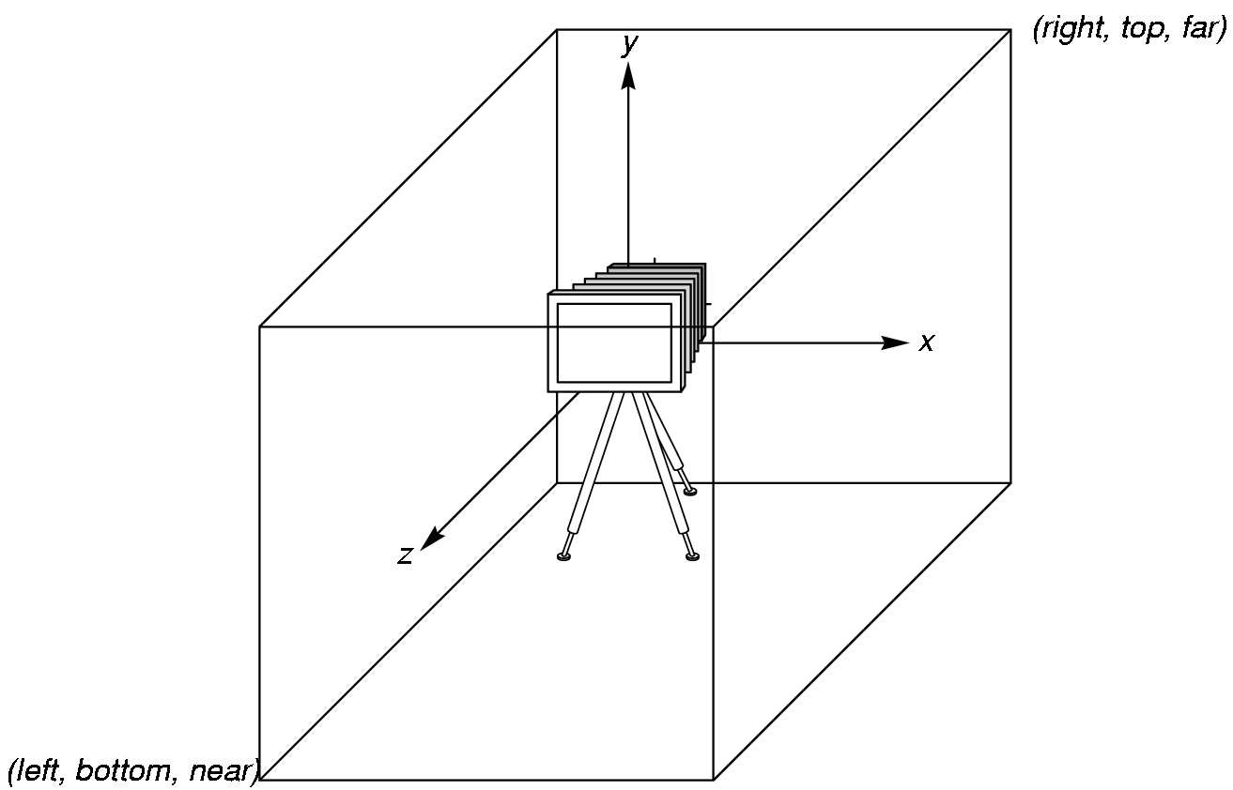
OpenGL Camera
OpenGL places a camera at the origin in object space pointing in the negative z direction
The default viewing volume
is a box centered at the
origin with a side of
length 2
Angel: Interactive Computer Graphics 5E © Addison-Wesley 2009

Slide 10
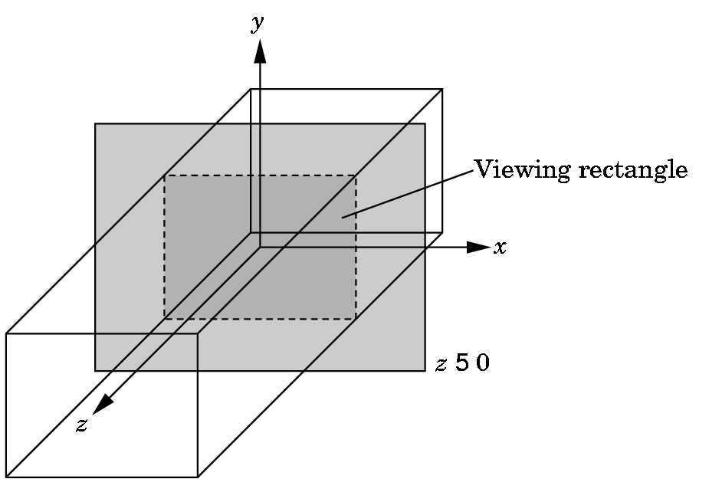
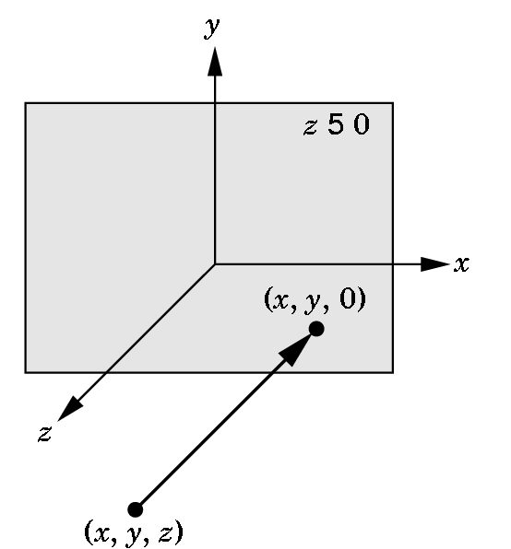
Orthographic Viewing
In the default orthographic view, points are
projected forward along the z axis onto the
plane z=0
z=0
z=0
Angel: Interactive Computer Graphics 5E © Addison-Wesley 2009

Slide 11
Transformations and Viewing
In OpenGL, projection is carried out by a projection matrix (transformation)
There is only one set of transformation functions so we must set the matrix mode first
glMatrixMode (GL_PROJECTION)
Transformation functions are incremental so we start with an identity matrix and alter it with a projection matrix that gives the view volume
glLoadIdentity();
glOrtho(-1.0, 1.0, -1.0, 1.0, -1.0, 1.0);
Angel: Interactive Computer Graphics 5E © Addison-Wesley 2009

Slide 12
Two- and three-dimensional viewing
In glOrtho(left, right, bottom, top, near, far) the near and far distances are measured from the camera
Two-dimensional vertex commands place all vertices in the plane z=0
If the application is in two dimensions, we can use the function
gluOrtho2D(left, right,bottom,top)
In two dimensions, the view or clipping volume becomes a clipping window
Angel: Interactive Computer Graphics 5E © Addison-Wesley 2009

Slide 13
mydisplay.c
void mydisplay()
{
glClear(GL_COLOR_BUFFER_BIT);
glBegin(GL_POLYGON);
glVertex2f(-0.5, -0.5);
glVertex2f(-0.5, 0.5);
glVertex2f(0.5, 0.5);
glVertex2f(0.5, -0.5);
glEnd();
glFlush();
}
Angel: Interactive Computer Graphics 5E © Addison-Wesley 2009

Slide 14
OpenGL Primitives
GL_POINTS
GL_POLYGON
GL_LINES
GL_LINE_STRIP
GL_LINE_LOOP
GL_TRIANGLES
GL_QUAD_STRIP
GL_TRIANGLE_STRIP
GL_TRIANGLE_FAN
Angel: Interactive Computer Graphics 5E © Addison-Wesley 2009

Slide 15
Polygon Issues
OpenGL will only display polygons correctly that are
  Simple: edges cannot cross
  Convex: All points on line segment between two points in a polygon are also in the polygon
  Flat: all vertices are in the same plane
User program can check if above true
  OpenGL will produce output if these conditions are violated but it may not be what is desired
Triangles satisfy all conditions
nonconvex polygon
nonsimple polygon
Angel: Interactive Computer Graphics 5E © Addison-Wesley 2009

Slide 16
Attributes
Attributes are part of the OpenGL state and determine the appearance of objects
  Color (points, lines, polygons)
  Size and width (points, lines)
  Stipple pattern (lines, polygons)
  Polygon mode
    Display as filled: solid color or stipple pattern
    Display edges
    Display vertices
Angel: Interactive Computer Graphics 5E © Addison-Wesley 2009

Slide 17
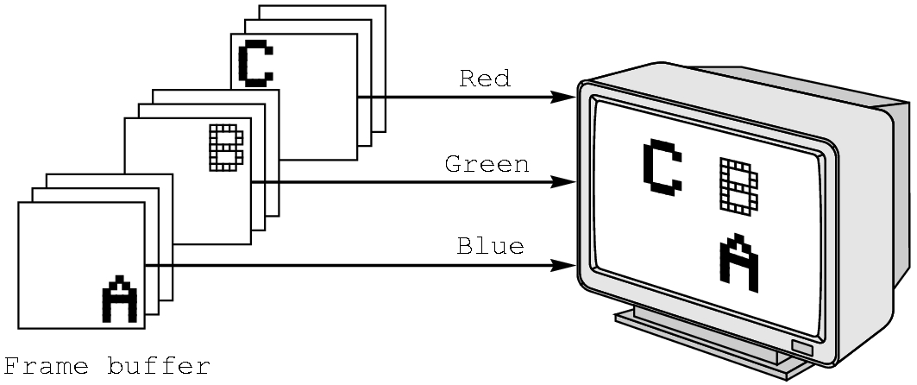
RGB color
Each color component is stored separately in the frame buffer
Usually 8 bits per component in buffer
Note in glColor3f the color values range from 0.0 (none) to 1.0 (all), whereas in glColor3ub the values range from 0 to 255
Angel: Interactive Computer Graphics 5E © Addison-Wesley 2009

Slide 18
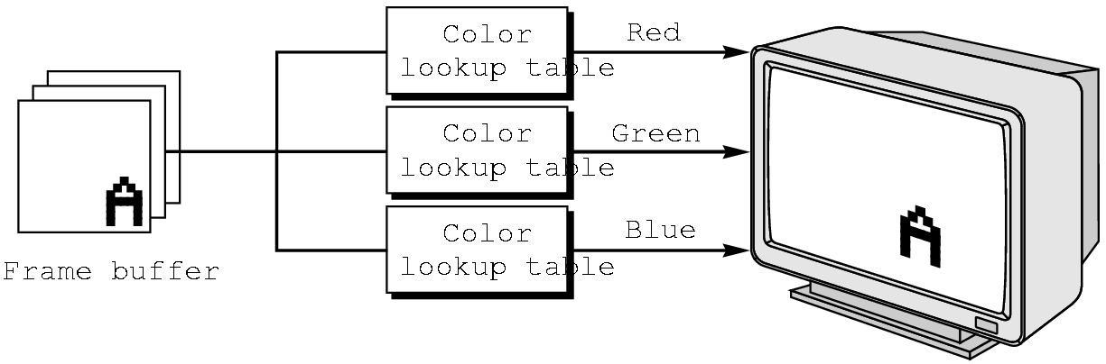
Indexed Color
Colors are indices into tables of RGB values
Requires less memory
  indices usually 8 bits
  not as important now
    Memory inexpensive
    Need more colors for shading
Angel: Interactive Computer Graphics 5E © Addison-Wesley 2009

Slide 19
Color and State
The color as set by glColor becomes part of the state and will be used until changed
  Colors and other attributes are not part of the object but are assigned when the object is rendered
We can create conceptual vertex colors by code such as
glColor
glVertex
glColor
glVertex
Angel: Interactive Computer Graphics 5E © Addison-Wesley 2009

Slide 20
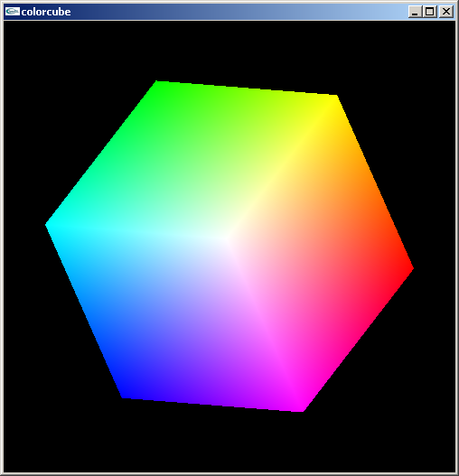
Smooth Color
Default is smooth shading
  OpenGL interpolates vertex colors across visible polygons
Alternative is flat shading
  Color of first vertex
  determines fill color
glShadeModel
  (GL_SMOOTH)
  or GL_FLAT
Angel: Interactive Computer Graphics 5E © Addison-Wesley 2009

Slide 21
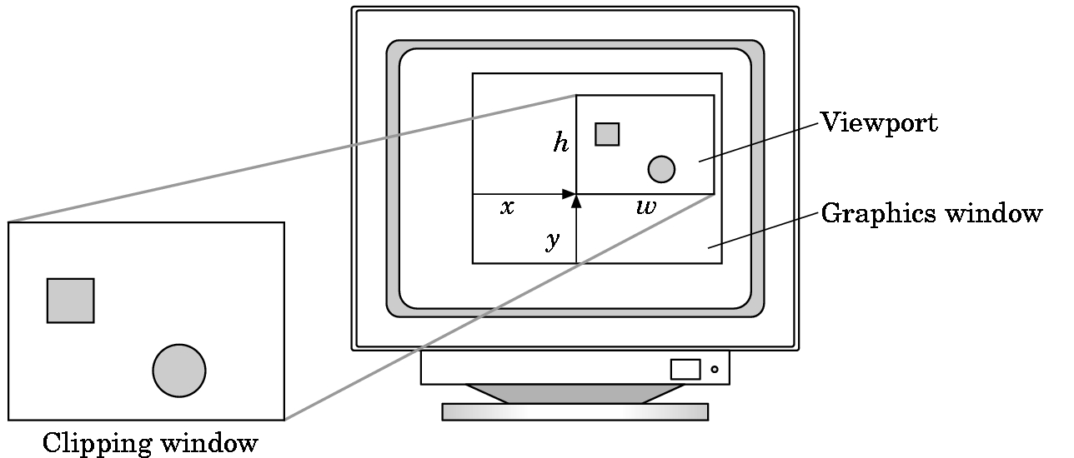
Viewports
Do not have use the entire window for the image: glViewport(x,y,w,h)
Values in pixels (screen coordinates)
Angel: Interactive Computer Graphics 5E © Addison-Wesley 2009

